Slide 1
HOUSE HUNT
CREATED BY :
KUNDURI SAI NIKHIL REDDY
MUNIGANTI VENU

Slide 2
Agenda
Introduction
Website Objective
Code Structure Snippets
Admin Snippets

Slide 3
HOUSE HUNT TECHNOLOGIES – DJANGO,BOOTSTRAP TOOLS - VSCODE
Django is a high-level Python web framework for rapid, scalable, and follows the principle of Don’t Repeat Yourself DRY development.
Bootstrap is a popular front-end framework for building responsive and visually appealing websites quickly and easily.
Visual Studio Code is a lightweight, versatile code editor.

Slide 4
Website objective
Help users find rental homes easily by letting them find based on what they need.
Provide Overall property details to users, including images, descriptions, and contact information, so they can decide better.
Implement filtering functionality to allow users to narrow down property search results based on specific criteria such as property type.
Allow users to book appointments to see homes in person, making it easier to find the right one.
Give users their own profiles to view appointments and keep Wishlist of favorite homes.
Let admins manage property listings and user accounts smoothly from one place.

Slide 5
MODULES CODE SNIPPETS

Slide 6
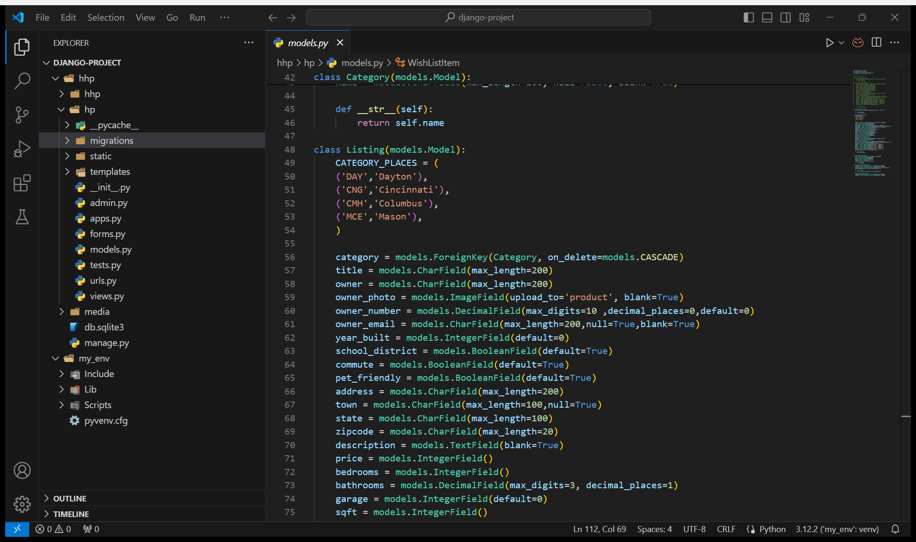
MODELS​
Define the structure and behavior of data within a web application, facilitating interaction with the underlying database.

Slide 7
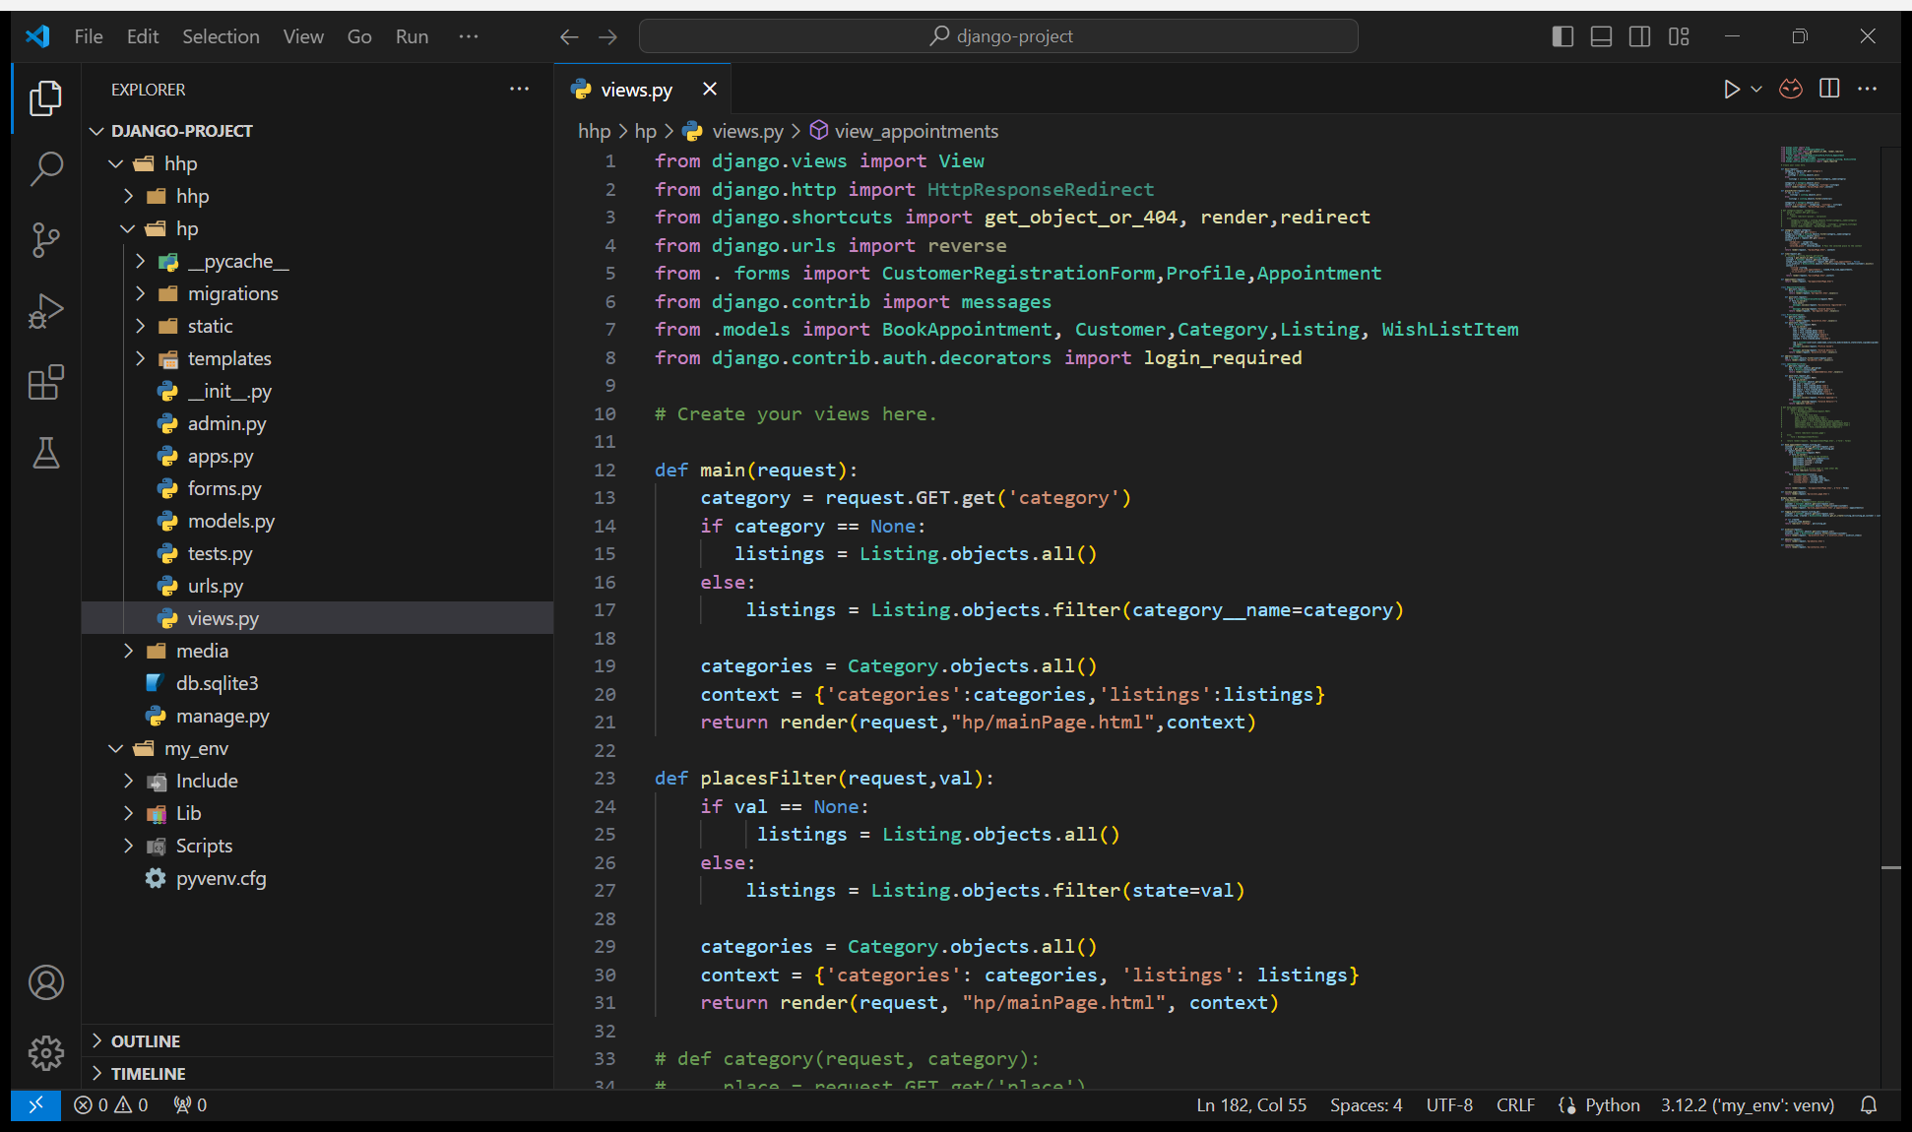
​views
Handle user requests, process data from models, and render appropriate responses to present dynamic content to users in web applications.

Slide 8
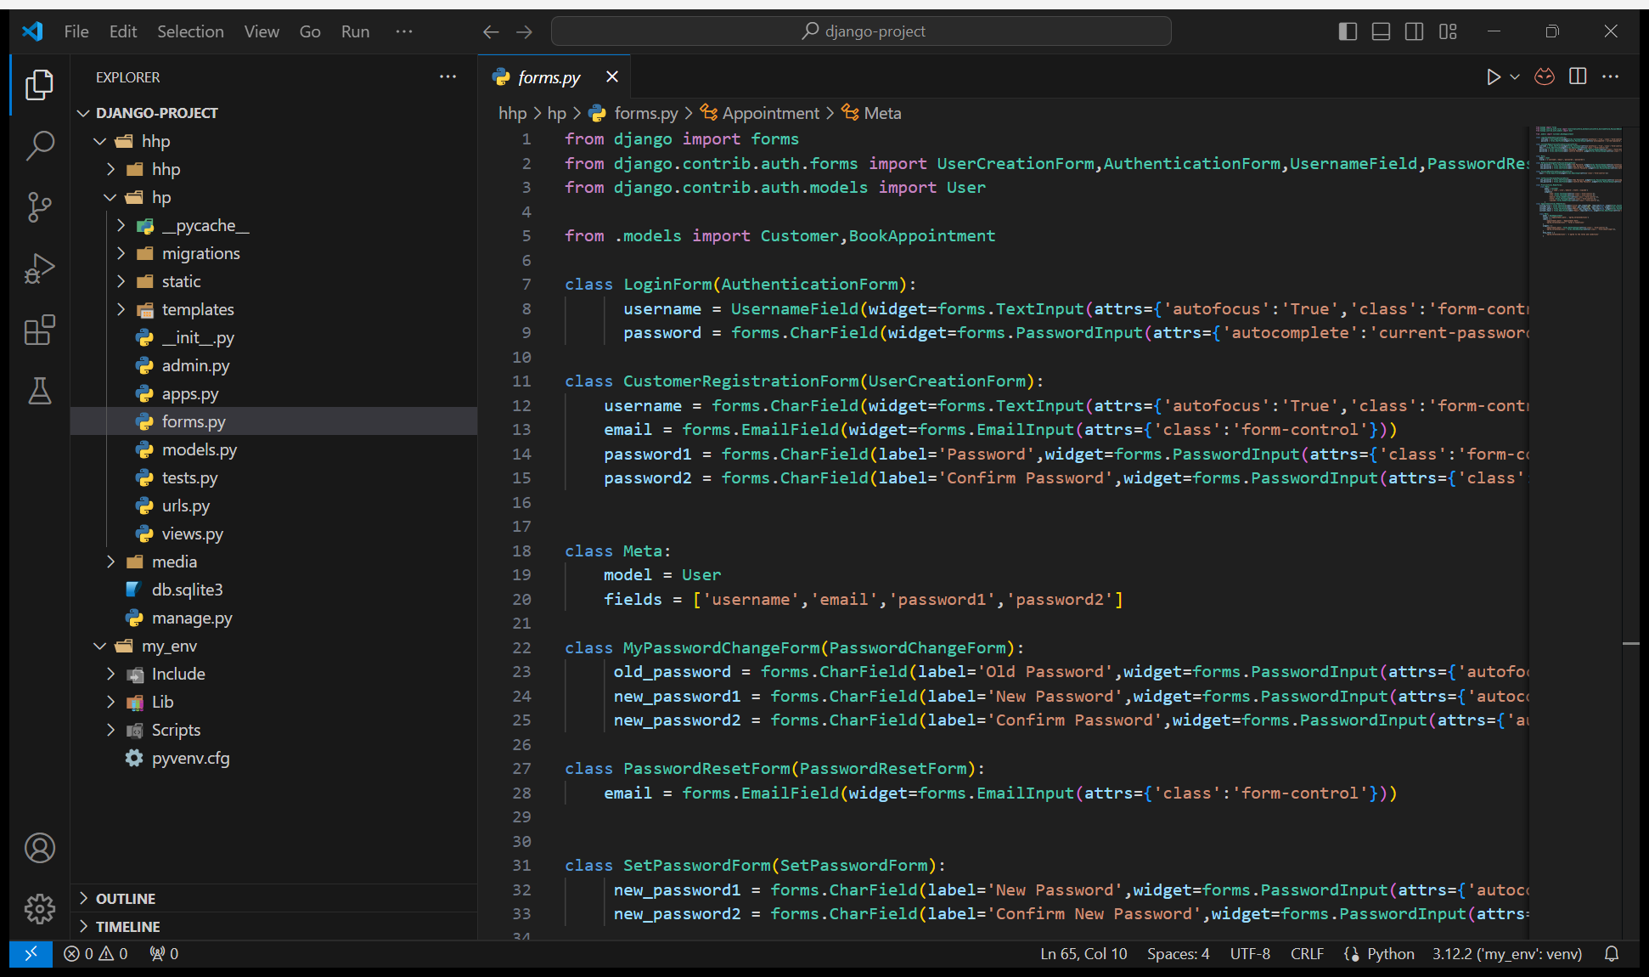
FORMS​
Simplify the collection of user data and validation process, facilitating the interaction between users and web applications by providing structured input fields and handling data submission.

Slide 9
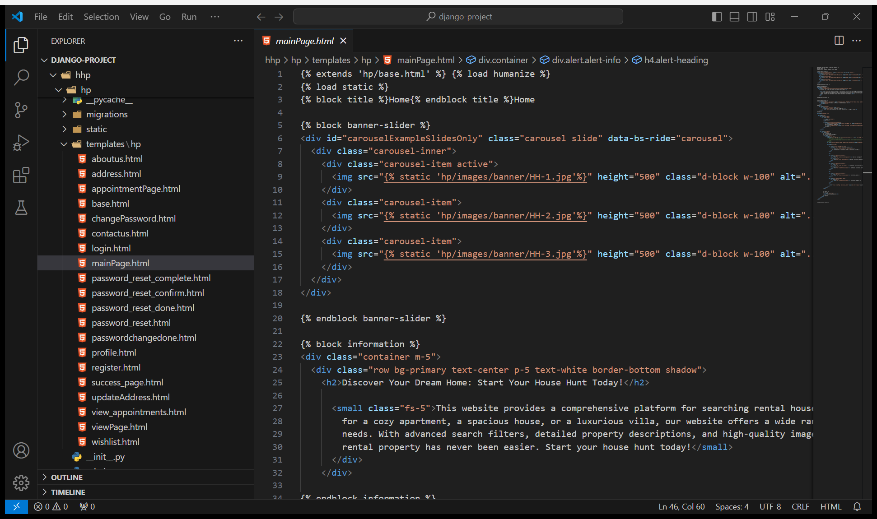
TEMPLATES
Combine HTML with Django's template language to generate dynamic web content from backend data, ensuring flexibility and reusability in presentation.

Slide 10
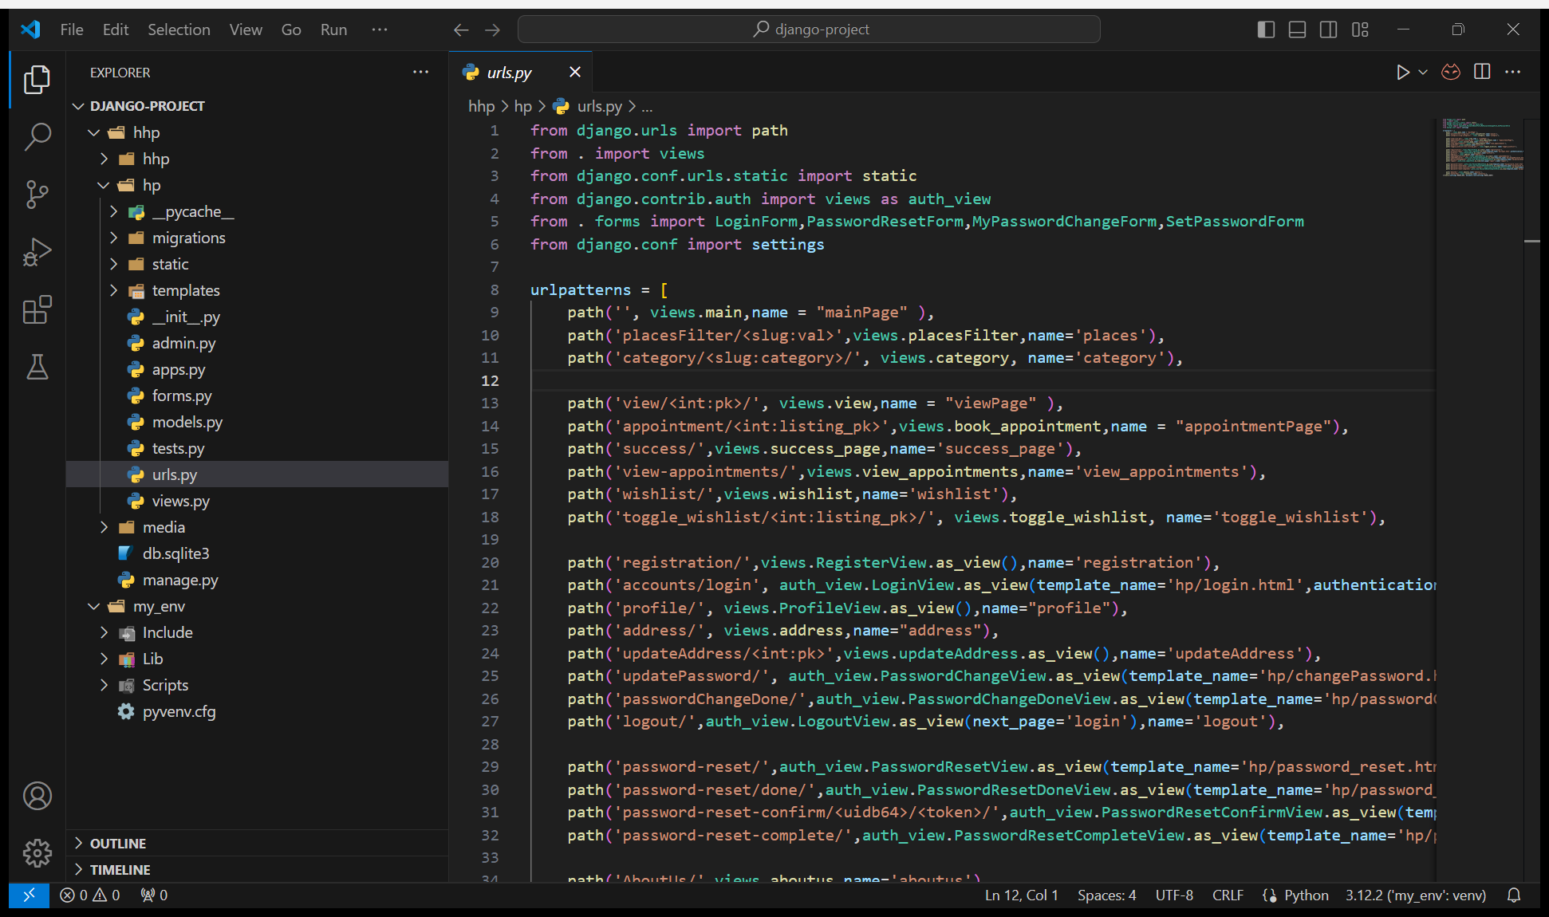
URLS
Map URLs to views, allowing navigation and access to different functionalities within the web application.

Slide 11
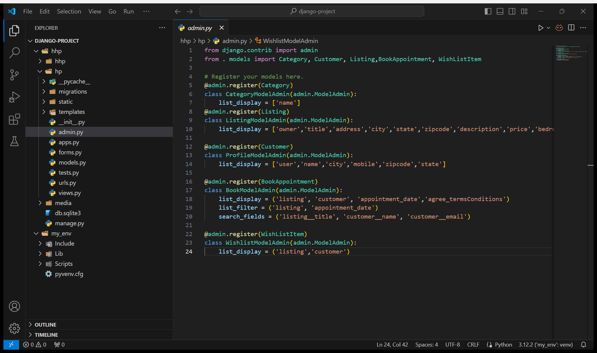
ADMIN
Register models for administration in Django admin interface.

Slide 12
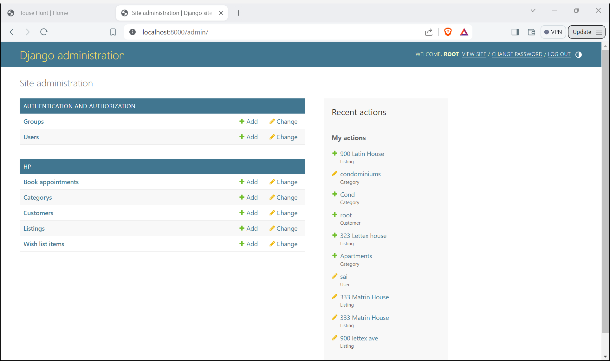
ADMIN PAGE
Interface for managing site content, users, and settings with ease.

Slide 13
THANK YOU

